Slide 1
13.11.20

Slide 2
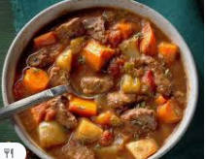
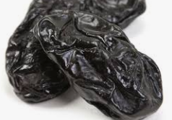
Alternative ue
How many ways can you make ue?

Slide 3
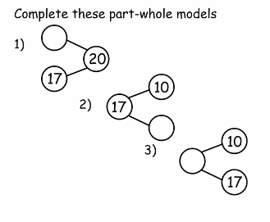
Once you have completed these part whole models see how part whole models you can make for the whole amount 16.

Slide 4
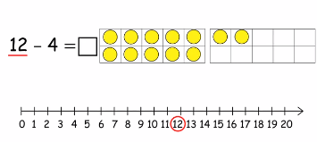
How can you partition 4 to subtract quickly?

Slide 5
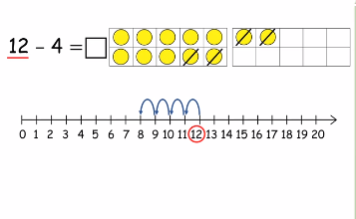

Slide 6
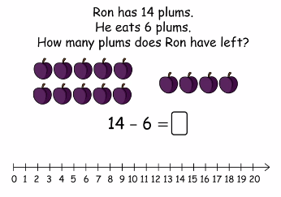
How can you partition 6 to subtract easily and quickly?

Slide 8
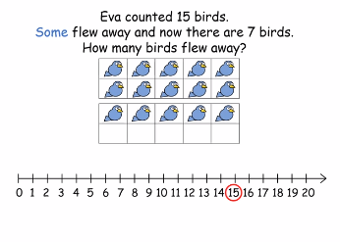
We know there are 15 birds and 7 are still there so we can use these numbers to make our calculation.
15-7=
How would you partition 7?

Slide 9
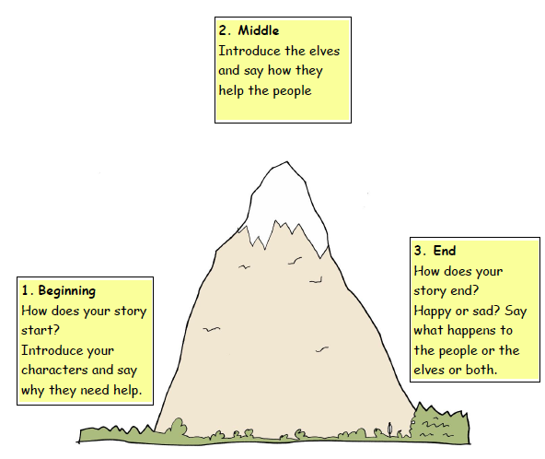
Have a go at writing your own stories.
Remember the elves need to help someone.
I look forward to hearing them.

