Slide 1

Year 1
13.11.20

Slide 2
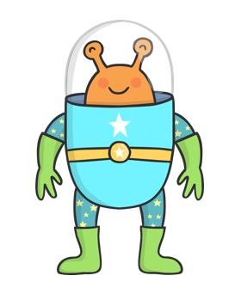





Today we are going to look at phase 4 words with one vowel cvcc and ccvcc.

Slide 3


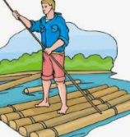
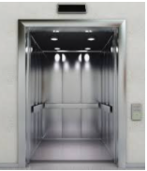

Slide 4

How quickly can you write your number bonds for the number 10?
On your marks get set go!...
I wonder how many number bonds there are for the number 11?

Slide 5
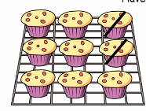
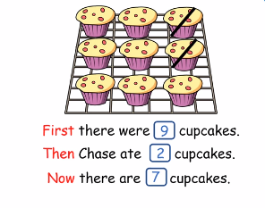

Slide 6
First there were 8 children on the bus and then 3 got off.
Now there are …. children on the bus.
8-3=

Slide 7
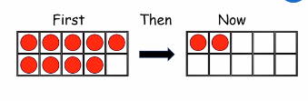
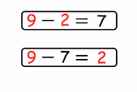
Which number sentence is correct?

Slide 8

Which number sentence is correct?

Slide 9


Slide 10
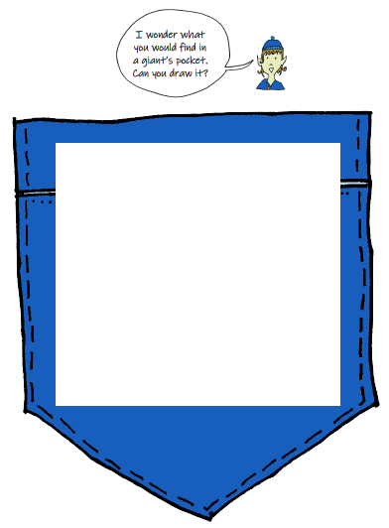
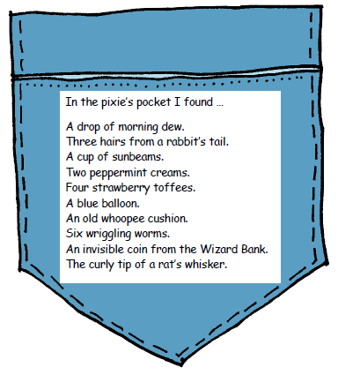
Pippety Skycap is only a very small pixie. What would a GIANT put in his pocket?

